Slide 1
Digital Image Processing Pycture Perfect
Lesson 6

Slide 2
Objectives
To understand pixel-based image processing
To use nested iteration
To use and understand tuples
To implement a number of image processing algorithms
To understand passing functions as parameters

Slide 3
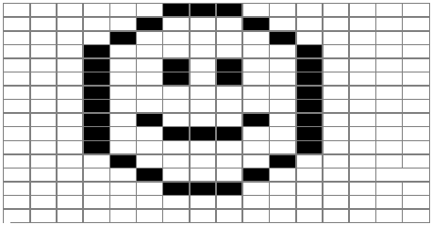

What makes an image?
A digital image is a finite collection of small, discrete picture elements called pixels.
Notes:
Digital Image = Collection of pixels are organized in a two-dimensional grid and represent the smallest amount of picture information that is available. If you look closely at an image, pixels can sometimes appear as small “dots.” More pixels in your image mean more detail or resolution.

Slide 4
What is digital image processing?
Digital image processing refers to the process of using algorithms to edit and manipulate digital images.
Negative imaging
Converting to grey scale
Resizing
Flipping
Edge detection
And more…

Slide 5
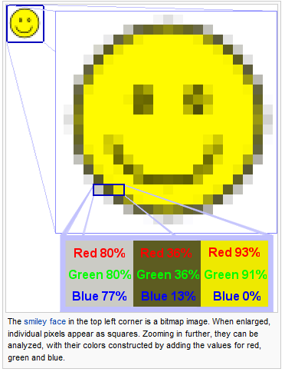
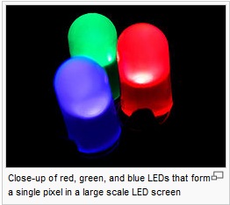
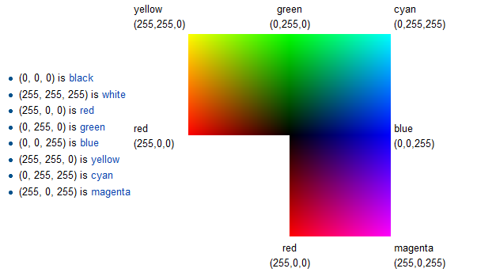
How are colored images stored?
Notes:
Each pixel in the digital image is limited to having a single color. The specific color
depends on a formula that mixes various amounts of the primary colors red, green, and
blue. Viewing colors as a combination of red, green, and blue is often referred to as the
RGB color model.
The amount of each primary color component is referred to as its intensity. Intensities
will range from a minimum of 0 to a maximum of 255. For example, a color with 255 red
intensity, 0 green intensity, and255 blue intensity will be purple (or magenta). Black will
have zero intensity for all primary color components andwhite will have full color intensity,
255, for all. Table 6.1 shows some common combinations.
An interesting question arises when you consider how many colors there might be using
the RGB color model. Since each of the three colors has 256 intensity levels, there are
2563 = 16,777,216 different combinations of red, green, and blue intensities. All of these
colors make up the color palette for the RGB color model.

Slide 6
cImage Module
Contains these objects to allow us to construct and manipulate pixels
Pixel object
ImageWin object
FileImage object
EmptyImage object
Notes:
In order to manipulate images we will use a group of objects found in our cImage module.
This module contains objects that allow us to construct and manipulate pixels. We can also construct
an image from a file or create a blank image that we can fill in later. In addition we can
create windows where images can be displayed.

Slide 7
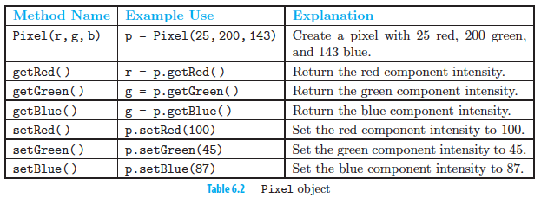
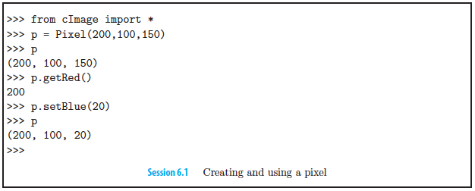
Pixel Object
Notes:
Images are collections of pixels. In order to represent a pixel, we need a way to collect
together the red, green, and blue components. The Pixel object provides a constructor
And methods that allow us to create and manipulate the color components of pixels. Table
6.2 shows the constructor and methods provided by pixel objects. Session 6.1 shows them in
action. The constructor will require the three color components. It will return a reference to
a Pixel object that can be accessed or modified. We can extract the color intensities using
the getRed, getGreen, and getBlue methods. Similarly, we can modify the individual
components within a pixel using setRed, setGreen, and setBlue.

Slide 8
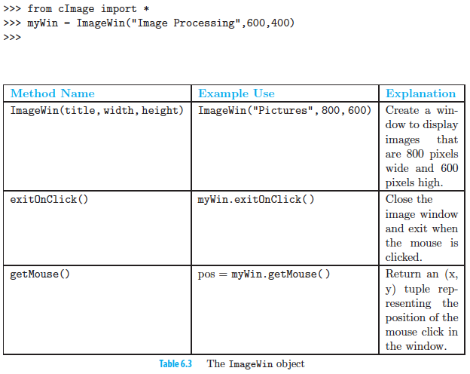
ImageWin Object
Notes:
Before creating images, we will create a window that can be used to display our images.
The ImageWin object provides a constructor that produces a window with a title, width,
and height. When a window is constructed, it is immediately shown. The code below
produces an empty window that is 600 pixels wide and 400 pixels high. Table 6.3 shows
additional methods for the ImageWin object. Note that the getMouse method returns a
coordinate position within the window itself and is not related to any particular image that
might be displayed within the window.

Slide 9
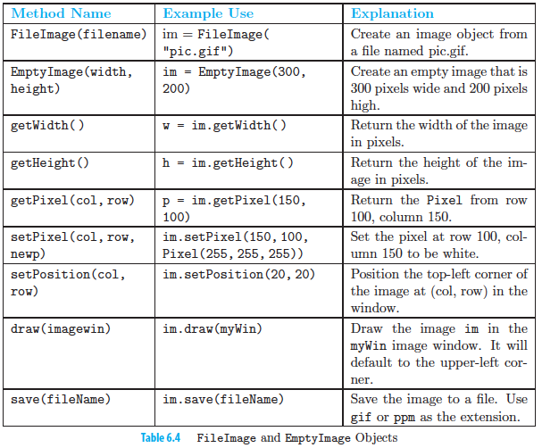
FileImage&EmptyImage
Notes:
Now that we have a window, we need to create images to display. The cImage module
provides two kinds of image objects: FileImage and EmptyImage. These objects allow us
to create and manipulate images, and they give us simple access to the pixels in each image.
Table 6.4 shows the two constructors for creating images as well as other methods that are
provided by both objects.

Slide 10
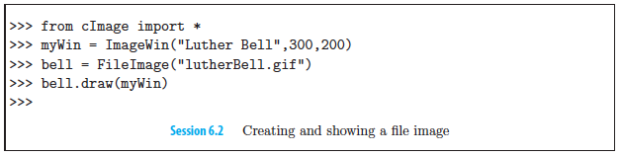
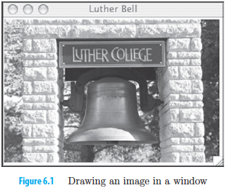
FileImage object
Notes:
The FileImage object is an image that is constructedfrom files such as those that are created
by digital cameras or that reside on web pages. For example, the file lutherBell.gif
was taken with an ordinary digital camera. Session 6.2 shows that the FileImage constructor
needs only the name of the image file. It converts the image stored in that file
to an image object. In this case, bell is the reference to that object. Finally, we can use
the draw method to ask the image object to show itself in an image window. The default
positioning is to place the image in the upper-left corner of the window. Figure 6.1 shows
the result.

Slide 11
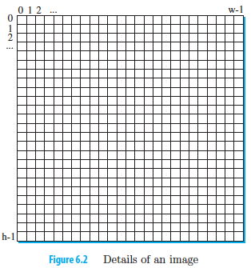
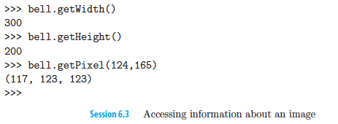
Accessing image info
Notes:
As we said earlier, an image is a two-dimensional grid of pixel values. Each small square in
Figure 6.2 represents a pixel that can take on any one of the millions of colors in the RGB
color model. We can access information about our specific image by using the getWidth
and getHeight methods (see Session 6.3). This image is 300 pixels across and 200 pixels
top to bottom. Rows are numbered from 0 to 1 less than the height of the image. Columns
are numbered from 0 to 1 less than the width.
We can access a particular pixel by using the getPixel method. To use getPixel, we
Need to provide the location for the pixel of interest. The location will be a pair of values,
one specifying the column and one specifying the row. Each unique column-row pair will
provide access to a single pixel.
In the example, we are accessing the pixel located at column 124, row 165. In other words,
it is the pixel that is 125 pixels from the left and166 pixels from the top. It is important
to remember that we start counting at 0. The value that is returned in our example shows
the red, green, and blue components of the Pixel at that location in our image.

Slide 12
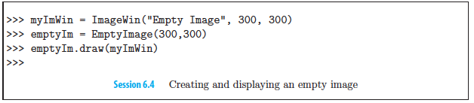
EmptyImageObject
Notes:
We often want to build a new image pixel by pixel starting with a “blank” image. Using
the EmptyImage constructor, we can create an image that has a specific width and height
but where each pixel is void of color. This means that each Pixel has the value (0,0,0)
or “black.” The statements in Session 6.4 create an empty image with all white pixels.

Slide 13
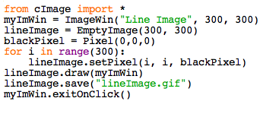
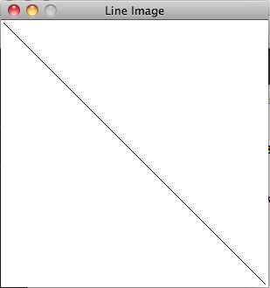
Drawing and Saving an Image
Notes:
As an example to show the basic use of the image methods, we will construct an image
that starts out empty and is filled with black pixels at specific locations. Session 6.5 starts
by creating a window and an empty image that is sized to fit within the window. In order
to create a line of black pixels, we use a loop variable i and iterate over the range from 0
to 299. The setPixel method can be called using the value of i for both column and row
with a pixel called blackPixel that has been created with a combination of red, green,
andblue corresponding to the color black. We draw the image in the window as shown in figure.
Finally, we save the image to a file using the save method.

Slide 14
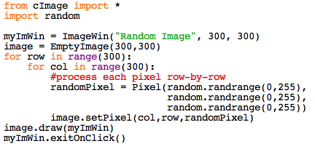
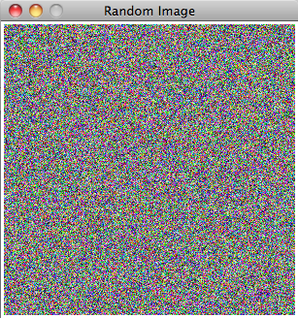
Processing the whole image using nested iteration
Notes:
In order to create the negative image, we call the negativePixel function on each pixel.
We need to come up with a pattern that will allow us to process each pixel. To do this, we
can think of the image as having a specific number of rows equal to the height of the image.
Each row in turn has a number of columns equal to the width of the image. With this in
mind, we can build an iteration that will systematically move through all of the rows and
within each, will move through all of the columns. This gives rise to the notion of nested
iteration—the placement of an iteration as the process inside of another iteration. In other
words, for each pass of the “outer” iteration, the “inner” iteration will run to completion.
The inner iteration will run from start to finish for each pass of the outer iteration.

Slide 15
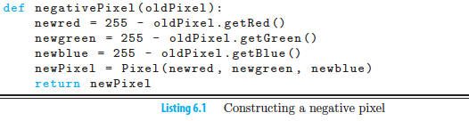
Basic Image Processing
Basic Process of converting a single pixel:
Extract the color components.
Build a new pixel.
Place that pixel in a new image at the same location as the original.
Notes:
When images are placed on film and then developed, a set of negatives is produced. A
negative image is also known as a color-reversed image. In a negative image, red becomes
cyan where cyan is the mixture of green and blue. Likewise, yellow becomes blue and blue
becomes yellow. Regions that are white turn black, black turns white, light turns dark and
dark turns light. This continues for all possible color combinations.
At the pixel level, the negative operation is just a matter of “reversing” the red, green, and
blue components in that pixel. Since color intensity ranges from 0 to 255, a pixel with a
large amount of a specific color—say, red—will have a small amount in the negative. At the
maximum, a pixel with a red intensity of 255 will have a red intensity of 0 in the negative.
This suggests that the way to create a negative pixel is to subtract each of the red, green,
and blue intensity values from 255. The results can then be placed in a new pixel.

Slide 16
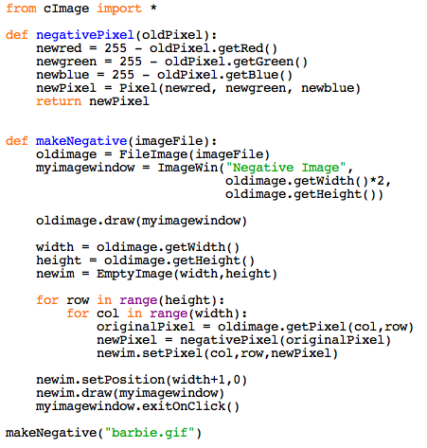
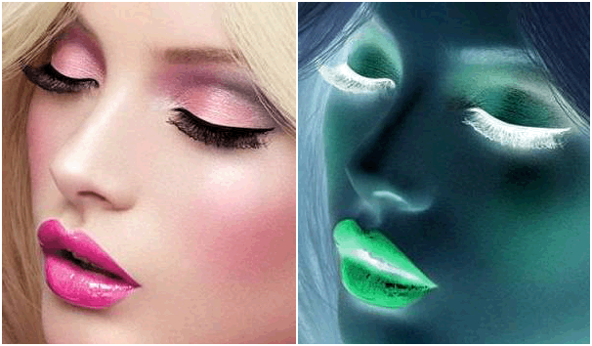
Negative Images
Notes:
At the pixel level, the negative operation is just a matter of “reversing” the red, green, and
blue components in that pixel. Since color intensity ranges from 0 to 255, a pixel with a
large amount of a specific color—say, red—will have a small amount in the negative. At the
maximum, a pixel with a red intensity of 255 will have a red intensity of 0 in the negative.
This suggests that the way to create a negative pixel is to subtract each of the red, green,
and blue intensity values from 255. The results can then be placed in a new pixel.
negativePixelfunction take a Pixel as a parameter and return the negative
pixel using the suggested process from above. Note that the function expects to receive an
entire Pixel and will decompose the color components, perform the subtractions, and then
build and return a new Pixel.

Slide 17
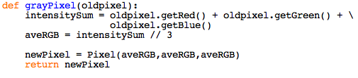
Grayscale image
http://www.j-a-b.net/web/hue/color-grayscale
Each red, green and blue will take on the same value.
Notes:
Another very common image color manipulation is to convert an image to grayscale, where
each pixel will be a shade of gray, ranging from very dark (black) to very light (white).
With grayscale, each of the red, green, and blue color components will take on the same
value. In other words there are 256 different grayscale color values ranging from darkest
(0, 0, 0) to lightest (255, 255, 255). The standard color known as “gray” is typically coded
as (128, 128, 128).
Our task then is to take each color pixel and convert it into a gray pixel. The easiest way
to do this is to consider that the intensity of each red, green, and blue component needs
to play a part in the intensity of the gray. If all of the color intensities are close to zero,
the resulting color is very dark, which should in turn show as a dark shade of gray. On the
other hand, if all of the color intensities are closer to 255, the resulting color is very light
and the resulting gray should be light as well.
This analysis gives rise to a simple but accurate formula for grayscale. We will simply take
the average intensity of the red, green, and blue components. This average can then be
Used for all three color components in a new pixel that will be a shade of gray.

Slide 18
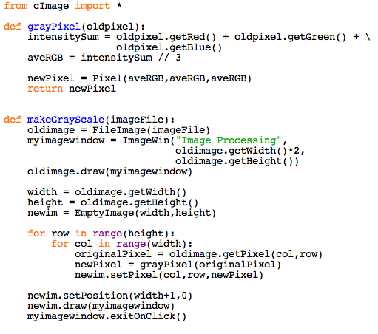
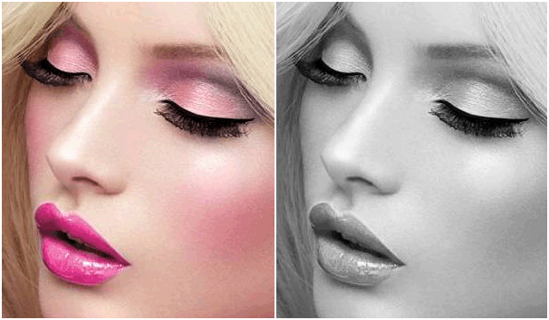
Grayscale Processing

Slide 19

Similarities?
Notes:
If you compare the Python listings for the makeGrayScale and makeNegative functions,
you will note that there is quite a bit of redundancy. In fact, the same steps were followed
with only one exception—namely, the function that was called to map each original pixel
into a new pixel. This similarity causes us to think that we could factor out the code that
is the same and create a more general Python function. This is another example of using
abstraction to solve problems.

Slide 20
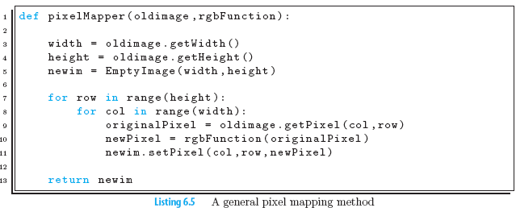
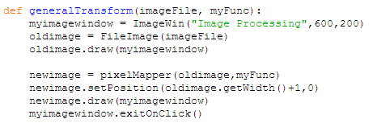
Notes:
The general pixelMapper function will take two parameters, an image and an RGB function. Lines 3–5 construct a new empty image that is the same size as the original. Line 10, which is inside of our nested iteration, does most
of the work. The rgbFunction parameter is applied to each pixel from the original image and the resulting pixel is placed in the new image. Once the nested iteration is complete, we will return the new image.
We can complete our example by calling the pixelMapper function using one of our RGB
functions from the previous sections. Listing 6.6 shows a main function, generalTransform,
that sets up the image window and loads the original image. Line 6 invokes pixelMapper
using the supplied rgbFunction.

Slide 21
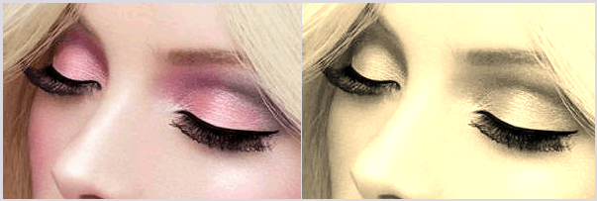
In-class exercise
Sepia tone is a brownish color
that was used for photographs in
times past.
The formula for creating a sepia tone is as follows:
newR = (R × 0.393 + G × 0.769 + B × 0.189)
newG= (R × 0.349 + G × 0.686 + B × 0.168)
newB = (R × 0.272 + G × 0.534 + B × 0.131)
Write an RGB function, sepiaPixel, to convert a pixel to sepia tone.
Use pixelMapper to test your RGB function.
Hint: Remember that RGB values must be integers between 0 and 255.

Slide 22
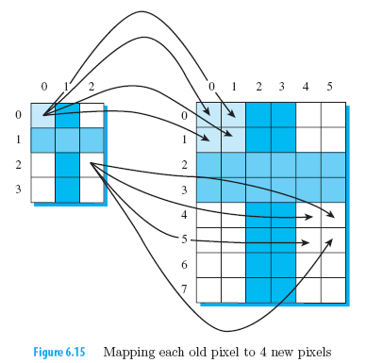
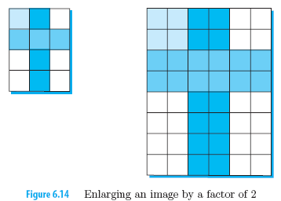
Advanced Image Processing
Resizing
Notes:
One of the most common manipulations performed on images is resizing—the process of increasing or decreasing the dimensions (width and height) of an image. In this section we focus on enlarging an image. In particular we consider the process of creating a new image that is twice the size of the original.
Each pixel of the original will be mapped into 4 pixels in the new image. Every 1-by-1 block of pixels in the original image is mapped into a 2-by-2 block in the new image. This results in the one-to-four mapping that be carried out for all of the original pixels. Our task is to discover a pattern for mapping a pixel from the original image onto the new image.

Slide 23
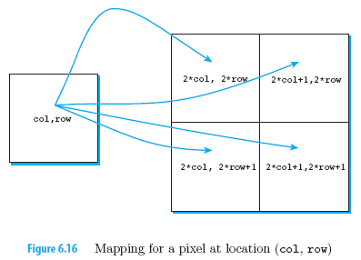
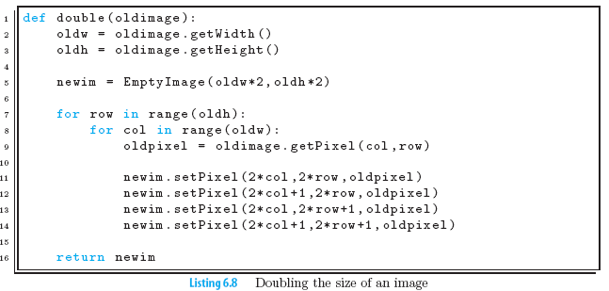
Double Image
Notes:
An example of this mapping process shows that pixel (0, 0) will be mapped to pixels (0, 0), (1, 0), (0, 1), (1, 1). Likewise, pixel (2, 2) maps to pixels (4, 4), (5, 4), (4, 5), (5, 5). Extending this pattern to the general case of a pixel with location (col, row) gives the four pixels (2 × col, 2 × row), (2 × col + 1, 2 × row), (2 × col, 2 × row + 1), (2 × col + 1, 2 × row + 1). Figure 6.16 illustrates the mapping equations for a particular
pixel. You should check your understanding by considering other pixels in the original
image.

Slide 24
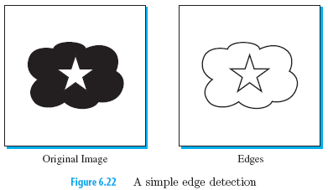
Edge Detection
Each black pixel in the edge image denotes a point where there is a distinct difference in the intensity of the original gray scale pixels.
Notes:
Our final image processing algorithm in this chapter is called edge detection—an image processing technique that tries to extract feature information from an image by finding places in the image that have very dramatic changes in color intensity values. consider the grayscale image (actually black and white) shown in
Figure 6.22. In the left image there are three objects: a white square, a cloud, and a star.
The right image shows the edges that exist. Each black pixel in the edge image denotes a
point where there is a distinct difference in the intensity of the original gray scale pixels.
Finding these edges helps to differentiate between any features that may exist in the original image.
There are many different approaches that can be used to find edges within an image. In this section we describe one of the classic algorithms for producing the edges, sobel operator.

Slide 25
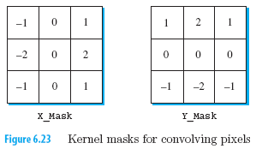
Convolution kernels
Kernels are used to weight the intensities of the surrounding pixels.
These “grids” of integer weights are known as the Sobel operators, named after Irwin Sobel who developed them for use in edge detection.
look for intensity differences in the left to right direction of the image
look for intensity differences in the up to down direction of the image
Notes:
The left mask, labeled XMask, will be used to look for intensity differences in the left to
right direction of the image. You can see that the leftmost column of values is negative
and the rightmost column is positive.
Likewise, the YMask will look for intensity differences in the up and down direction as can be seen by the location of the positive and negative weights.

Slide 26
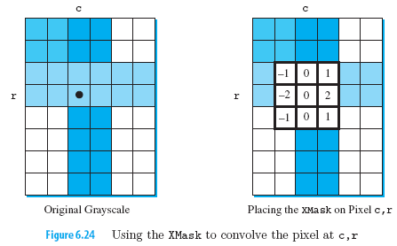
Convolution process
Pixels in the original image will be mathematically combined with each mask. The result will then be used to decide whether that pixel represents an edge.
Convolution will require a mask and a specific pixel. The mask will be “centered” on the pixel of interest.
origPixel = pixel.getRed()
Compute the sum of nine products where each product is the weight
multiplied by the intensity of the original pixel.
Notes:
Convolution will require a mask and a specific pixel. The mask will be “centered” on the
pixel of interest, as shown in Figure 6.24.
Each weight value in the mask now associates with one of the nine pixel intensities “under” the mask. The convolution process will simply compute the sum of nine products where each product is the weight multiplied by the intensity of the associated pixel. If you have a large intensity on the left side and a small intensity on the right (indicating an edge), you will get a weighted sum with a large negative value. If you have a small intensity on the left and a large intensity on the right, you will get a large positive weighted sum. Either way a large absolute value of the weighted sum will indicate an edge. This same argument applies for the top-to-bottom split of the YMask.

Slide 27

Modelling the kernel
Modelling it as a list:
xMask = [[-1,0,1], [-2,0,2],[-1,0,1]]
Accessing particular weight
2 indices: rowIndex & colIndex
xMask[2][2]
xMask kernel

Slide 28
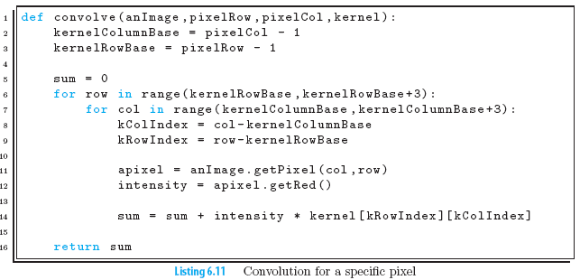
Notes:
We can now construct the convolve function.
This process requires an image, a specific pixel within the image, and a kernel.
The tricky part of this function is to align the kernel and the underlying image. An easy way to do this is to think about a mapping. The kernel row indices will run from 0 to 2. Likewise for the column indices. For a pixel in the image with index (column,row), the row indices for the underlying pixels will run from row-1 to row+1 andfor the columns it will be column-1 to column+1.
We will define the base index to be the starting index for the 3×3 grid of underlying image pixels. The base index for the columns will be column-1 and the base index for the rows will be row-1 (line 2 -3).
As we process the pixels of the image, the difference between the current image row value and the base index for the rows will be equal to the row index needed to access the correct row in the kernel. Likewise, we can do the same thing for the columns.
Once we have computed the index into the kernel (line 8-9) we can use it to compute the product of the weight and the pixel intensity.
We will first access the pixel and then extract the red component that will be its gray scale intensity. Since we have already converted the image to gray scale, we can use any one of the red, green, or blue components for the intensity.
Finally, that product can be added to a running sum of products for all underlying pixels (line 14).
The complete convolve function is shown in Listing 6.11. Note that the final step is to
return the value of the sum.

Slide 29
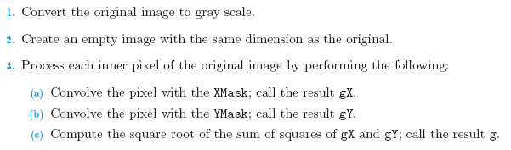
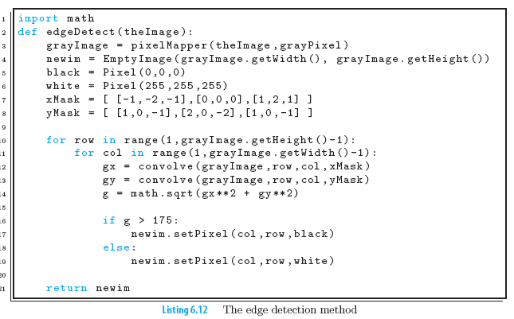
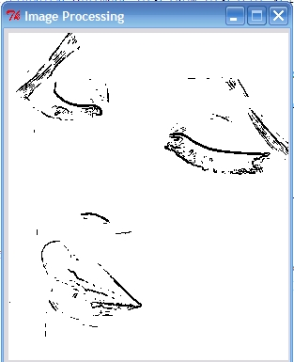
Notes:
Now that we can perform the convolution operation for a specific pixel with a kernel, we
can complete the edge detection algorithm. The steps of edge detection is outline as above.
The value of this square root, called g, represents a measure of how much difference exists between the pixel and those around it. The decision as to whether the pixel should be labeled as an edge is made by comparing g to a threshold value.
It turns out that when using these kernels, 175 is a goodthresholdv alue for considering whether you have found an edge. Using simple selection, we will just check to see if the value is greater than 175. If it is, we will color the pixel black; otherwise we will make it white.

Slide 30
Recap
Use of nested loops to process digital images
Observe generic patterns in function usage, and re-write “function mappers”
Python treats functions as normal data objects, i.e. you can pass functions as a parameter to another function.

